Slide 1
2018 OUTLOOK:
An Object in Motion Stays in Motion
Dan Phillips, CFA
Northern Trust Asset Management
Director, Asset Allocation Strategy

Slide 2






Themes to watch in the years ahead
Entrenched
Growth
Waiting for
Monetary Godot
Valuation
Superstructure
Populist
Catharsis
Regulation in
the Limelight
Stuckflation
Source: Northern Trust Investment Strategy.

Slide 3

Themes driving markets right now
Entrenched
Growth
Waiting for
Monetary Godot
Valuation
Superstructure
Populist
Catharsis
Regulation in
the Limelight
Stuckflation
Source: Northern Trust Investment Strategy.

Slide 4
A year to remember…
Source: Northern Trust Investment Strategy, Bloomberg.

Slide 5
…with strong returns overseas
Source: Northern Trust Investment Strategy, Bloomberg.

Slide 6
Equities: Hitting the new year running
Source: Northern Trust Investment Strategy, Bloomberg

Slide 7
Fixed Income: Taking credit
2017 RETURNS
2018 FORECASTS
Source: Northern Trust Investment Strategy, Bloomberg

Slide 8
Interest Rates: Its all only slightly uphill from here
Source: Northern Trust Investment Strategy, Bloomberg.

Slide 9
Asset Allocation – Global Policy Model
Source: Northern Trust Investment Strategy.

Slide 10
Key Takeaways
Equities have ROOM TO RUN as we head into 2018
ENTRENCHED GROWTH & STUCKFLATION, a powerful combination
Absolute valuations elevated but RELATIVE VALUATIONS REASONABLE
WATCH RISK CASES of Monetary Misstep and China Slowdown.
Ensure risk positioning is ALIGNED WITH RISK TOLERANCE
Source: xxx

Slide 11
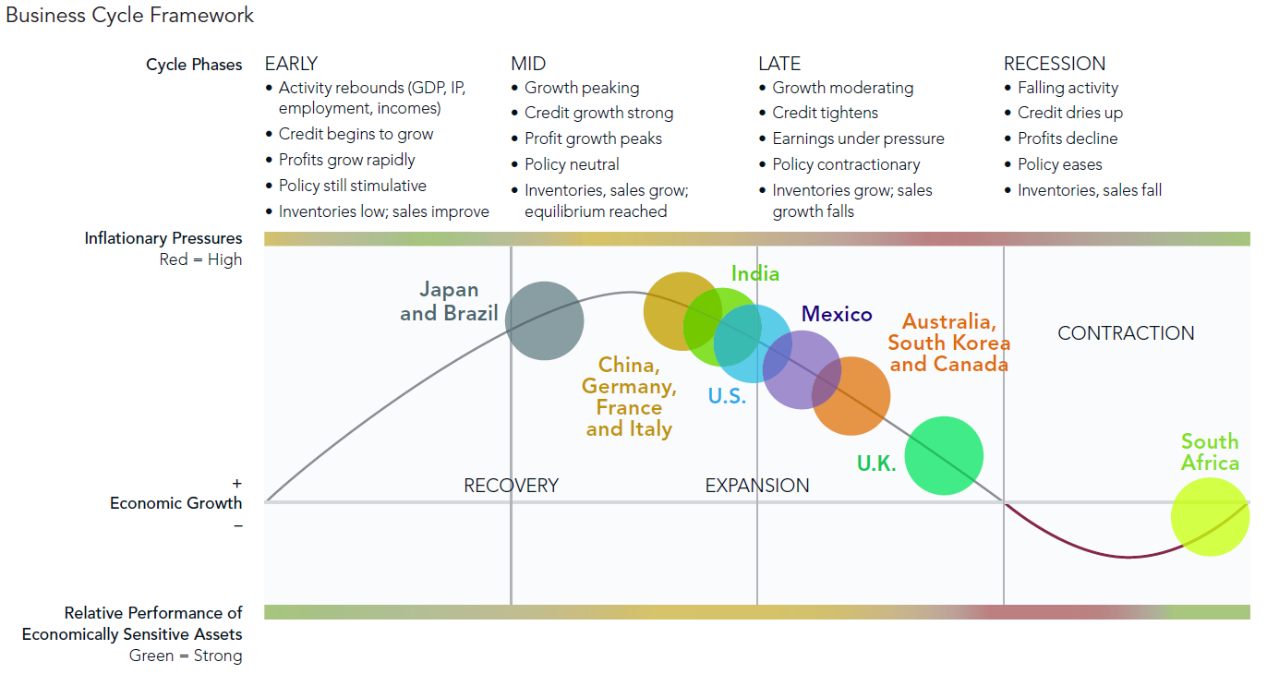
Most of the world’s major economies remain in expansion.
Source: Fidelity.

Slide 12
All S&P 500 monthly returns were positive in 2017.
Source: Factset, Data through 12/31/2017. Price data shown on logarithmic scale. Past performance does not guarantee future results.

Slide 13
Only 3 days +/- 1% daily market move
2017 saw one day of >1% gains and two days of >1% losses
Source: Bloomberg. Past performance does not guarantee future results.

Slide 14
U.S. and Int’l Equities at an inflection point?
Source: JP Morgan, Bloomberg. Past performance does not guarantee future results.

Slide 15
Where do we go from here?
Source: Bloomberg. Past performance does not guarantee future results.

Slide 16
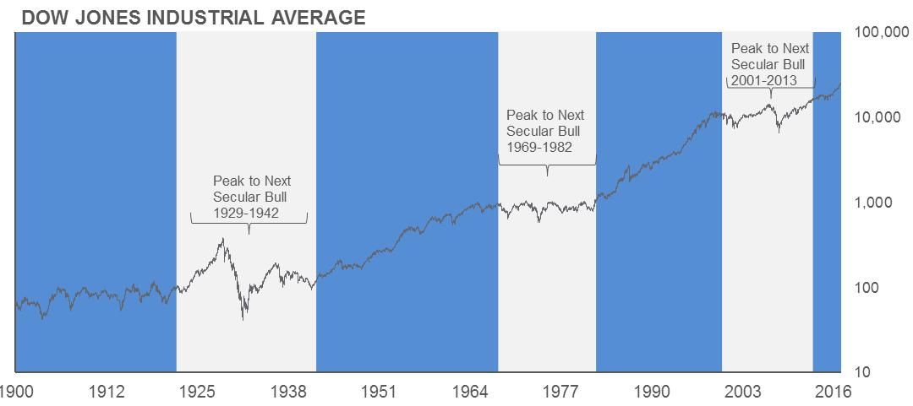
Have Equities broken out into a new secular bull market in 2013?
Source: Factset, Data through 12/31/2017. Price data shown on logarithmic scale. Past performance does not guarantee future results.

Slide 17
Still a tremendous amount of cash on the sidelines losing money to inflation.
Source: Bloomberg. Past performance does not guarantee future results.

Slide 18
Still a tremendous amount of cash on the sidelines losing money to inflation.
Source: JP Morgan.

Slide 19
Trying to time the market can cost more than the correction itself.
“Far more money has been lost by investors preparing for corrections, or trying to anticipate corrections, than has been lost in corrections themselves.”
-Peter Lynch

Slide 20
Sitting on the sidelines can be costly.
Source: JP Morgan, Bloomberg. Past performance does not guarantee future results.

Slide 21
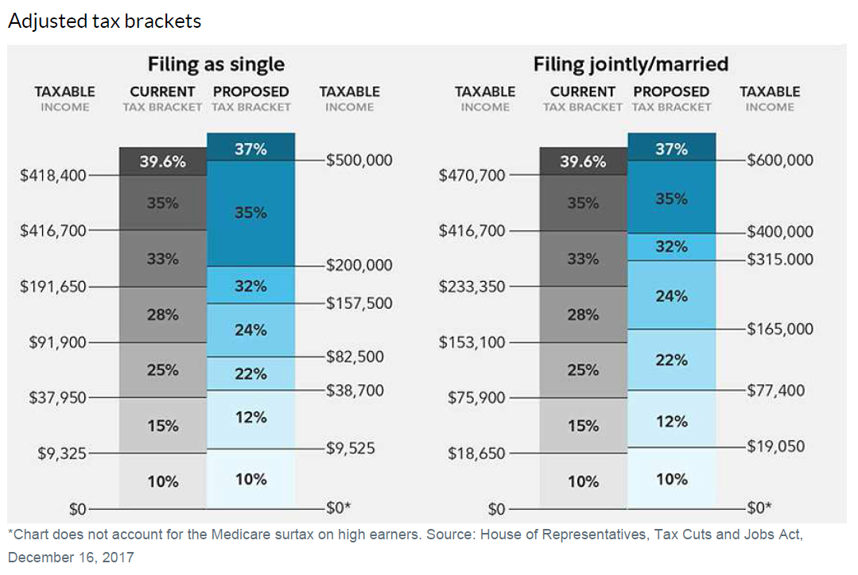
Individual Tax Bracket Changes for 2018
Source: Fidelity.

Slide 22
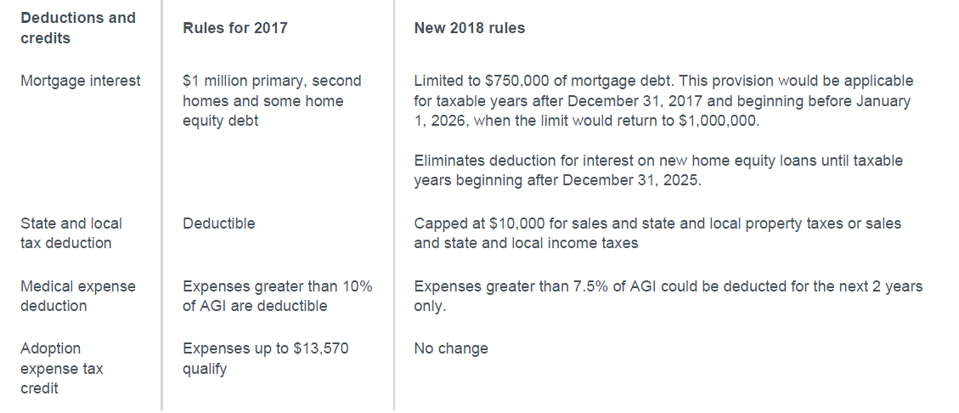
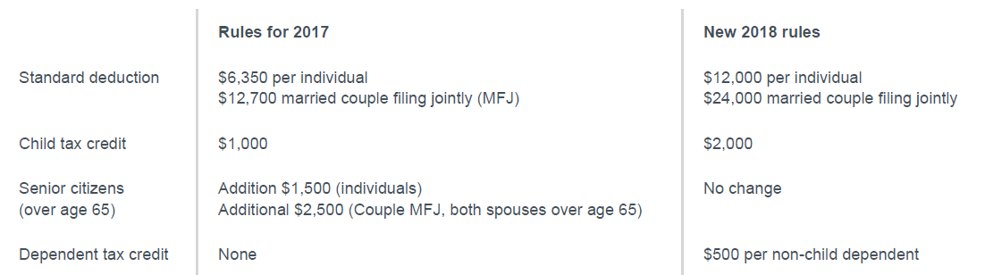
2018 Changes to Deductions and Credits
Source: Fidelity.

Slide 23
Corporate Taxes reduced from 35% to 21%
Source: Fidelity, Haver Analytics, FactSet. Past performance does not guarantee future results.

