Slide 1
Quad Cities Estate Planning Council
The Hybrid Domestic Asset Protection Trust: A Third-Party Trust that can turn into
a Self-Settled Trust
Presented by
Michael W Halloran, AEP Distinguished,
CLU ® ChFC ®, CFP ®, RICP ®

Slide 2

Domestic Asset
Protection Trust
A DAPT is a U.S. asset protection trust in which the trust grantor is a permissible beneficiary

Slide 3

Domestic Asset
Protection Trust
Pre-existing creditors versus non pre-existing creditors
Fraudulent conveyance laws—transfer with the intent to hinder, defraud or delay

Slide 4
Statutory Exception Creditors
Fifteen of seventeen states have statutory exception creditors
  Such as divorcing spouses, alimony, child support
  Such as pre-existing tort creditors

Slide 5
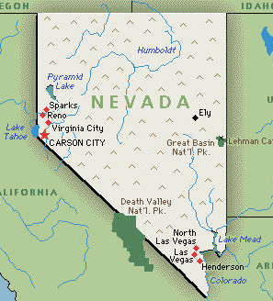
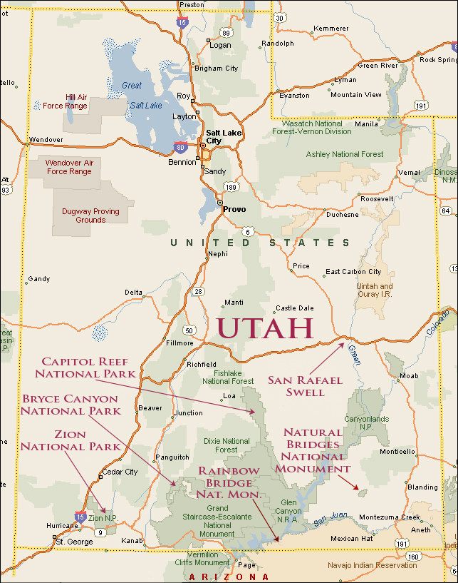
Statutory Exception Creditors
Nevada and Utah = only states with no statutory exception creditors

Slide 6

Ease of Use
Seven of the states require a new affidavit of solvency for EVERY transfer to the DAPT
  Alaska, Michigan (not completely required), Mississippi, Ohio (not completely required), Tennessee, Utah and Wyoming
  Not user-friendly

Slide 7
Nevada Asset Protection Trust
Powers
Grantor can be an investment trustee per NRS 166.040.3
Grantor cannot be distribution trustee per NRS 166.040.2(b)
At least one trustee must be Nevada natural person, trust company or bank per NRS 166.015.2
Grantor can retain power to fire and hire trustees per NRS 166.040.3
Grantor can retain veto power and lifetime/testamentary POA per NRS 166.040.2(a)

Slide 8
Does a DAPT Work?
A DAPT definitely works for a resident of the DAPT state
Does it work for a resident of a non-DAPT state who sets it up under the laws of a DAPT state?
  Two cases
    Dahl v. Dahl
    In re Huber

Slide 9

Does a DAPT Work?
If almost all potential creditors have been frustrated to the point where they choose to either settle the dispute or go away altogether, doesn’t this mean that almost EVERY DAPT has worked?

Slide 10
Third-Party Irrevocable Trusts
Third-Party Irrevocable Trusts are irrevocable trusts in which the grantor is not a beneficiary
Grantor can be a trustee
Grantor can retain the power to fire and hire trustees
Use a “floating spouse” provision

Slide 11

Third-Party Irrevocable Trusts
If grantor loses his assets, his spouse can take care of him
We know for a fact that a Third-Party Irrevocable Trust works to protect its assets from creditors of the beneficiaries

Slide 12

Which Would You Rather?
Even if you aren’t a beneficiary, from a pure asset protection standpoint, which would you rather?

Slide 13

Which Would You Rather?
Option 1: $10M net worth
  If you’re sued and the judgment is for more than $10M, you’re broke

Slide 14
Which Would You Rather?
Option 2: $10M net worth
  Transfer $2M to irrevocable trust for spouse and descendants, so you now have $8M
  If you’re sued and the judgment is for more than $8M, you’re broke, but you can indirectly live off of the $2M irrevocable trust

Slide 15

Which Would You Rather?
$10M net worth
  Transferred $2M to discretionary trust for spouse and descendants
  Have $8M left

Slide 16
Which Would You Rather?
What if you get divorced?
  $2M in discretionary trust is not part of marital estate, so only the $8M is part of the marital estate
  Therefore, the marital division doesn’t include the $2M
  However, you can indirectly access the $2M in the future through your next spouse (floating spouse) or your children

Slide 17
Hybrid DAPT
A “Hybrid DAPT” is a Third-Party Irrevocable Trust that can be turned into a DAPT
  Concept applies to incomplete gift or completed gift
Does the grantor really need to see his name in the trust agreement as a discretionary beneficiary?
  Assuming a good relationship with spouse, a trust for spouse and descendants isn’t much different than a DAPT
  Give Trust Protector the power to add the grantor or remove the grantor as a permissible beneficiary

Slide 18

Getting Cash Flow
Without Being a Beneficiary
Assume grantor sets up Hybrid DAPT for benefit of spouse and descendants

Slide 19
Getting Cash Flow
Without Being a Beneficiary
Ways to access cash flow?
  Distribution to spouse who shares it with grantor
  Sell assets to Hybrid DAPT for promissory note
    So Hybrid DAPT can get cash flow to grantor by paying down promissory note
  Give beneficiary a power of appointment and have beneficiary appoint assets back to the grantor
  Have trust loan money to the grantor for promissory note

Slide 20

Getting Cash Flow
Without Being a Beneficiary
Only after consideration of all of the above options, last resort is to ask Trust Protector to add grantor as a beneficiary

Slide 21
Down and Dirty
Splitting the Trust
Another option is to have the trustee split the Hybrid DAPT into two separate trusts
  Trust A = Clean Trust: Still a Hybrid DAPT
  Trust B = Dirty Trust: Grantor is added in as a discretionary beneficiary and multiple distributions are made to him without hesitation
We know the Clean Trust still works
The Dirty Trust might not work, but at least we protected the Clean Trust assets

Slide 22
Down and Dirty
Example
Grantor’s Hybrid DAPT has $5 million of assets
  Grantor wants some distributions
Let’s not “taint” the entire $5 million trust
  If no current creditor issues: Trustee splits the Hybrid DAPT into two trusts: Trust A (the Clean Trust) with $4 million and Trust B (the Dirty Trust) with $1 million
    Only the $1 million in the Dirty Trust is potentially tainted
  If current creditor issues: Only split off $300,000 into Dirty Trust
    Only the $300,000 in the Dirty Trust is potentially tainted

Slide 23

Thank You For
Attending Today’s Seminar
Steven J. Oshins, Esq., AEP (Distinguished)
Law Offices of Oshins & Associates, LLC
1645 Village Center Cir., Ste. 170
Las Vegas, NV 89134
Phone: 702-341-6000
Fax: 702-341-6001
Website: www.oshins.com
Email: soshins@oshins.com

